Slide 1
Cross-Cloud Connectivity University of British Columbia - ICCS – Vancouver, Canada
Diego Casati – Senior Software Engineer
Commercial Software Engineering

Slide 2
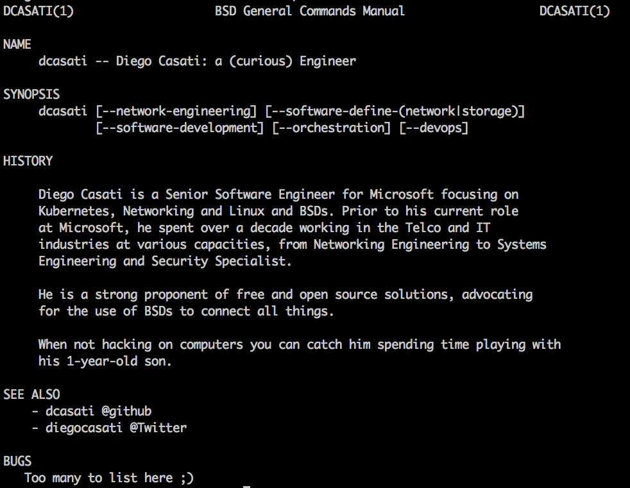

Slide 3


Slide 4
Cross-Cloud Connectivity
What worked, what failed and lessons learned.

Slide 5
Ignite your curiosity by showing a real use case of an engineering exercise.
Key objective

Slide 6
What? Why? Where? How?
Main()

Slide 7
Deploy Cassandra on top of Kubernetes spanning two clouds
What?

Slide 8
Wait? What? Let me check online

Slide 9
Proactive exercise simulating Customers looking to (1) migrate or have their workload (2) spanning in two clouds
Why?

Slide 10
Why?
For replication (e.g.: backup)
To comply with a scheduled downtime (e.g.: keep a service running by moving data between Data Centers)
Cost
(1) migrate or have their workload

Slide 11
Why?
To increased availability
To provide load balancing
To connect to an existing Data Center (e.g.: on premise)
(2) spanning in two clouds

Slide 12
AWS Azure
Where?

Slide 13
site-to-site VPN between the clouds using open source components
How?

Slide 14
END-TO-END TOPOLOGY - NETWORK
VPN

Slide 16
Common Vocabulary
Acronym | Explanation
Jumpbox | A jump server is a hardened and monitored device that spans two dissimilar security zones and provides a controlled means of access between them.
VPN | A virtual private network (VPN) extends a private network across a public network, and enables users to send and receive data across shared or public networks as if their computing devices were directly connected to the private network.

Slide 17
AWS Vocabulary
Acronym | Explanation
VPC | A virtual private cloud (VPC) is a virtual network dedicated to your AWS account.
EIP | An Elastic IP address is a static, public IPv4 address designed for dynamic cloud computing.
Security Group | A security group acts as a virtual firewall for your instance to control inbound and outbound traffic

Slide 18
Azure Vocabulary
Acronym | Explanation
VNET | Azure Virtual Network enables Azure resources to communicate with each other and the internet.
PIP | A PIP is a public instance-level IP address associated with the VM in addition to the VIP.
NSG | A network security group (NSG) contains a list of security rules that allow or deny network traffic to resources connected to Azure Virtual Networks (VNet).
UDR | User defined routes

Slide 19
Let’s breakdown the solution

Slide 20
The solution – in pieces
Solution | AWS | Azure
Database | Cassandra | Cassandra
Compute | Kubernetes | Kubernetes
Network | ????

Slide 21
Database: Cassandra

Slide 22
Apache Cassandra is a free and open-source distributed NoSQL database management system designed to handle large amounts of data across many commodity servers, providing high availability with no single point of failure

Slide 23
Containers

Slide 24
Why do we need containers?

Slide 25
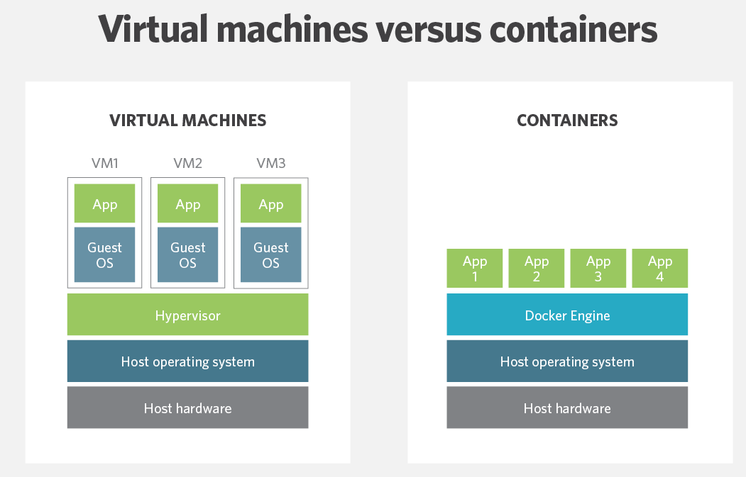

Slide 26
PETS VS CATTLE

Slide 27
Any issues with containers?

Slide 28
Containers Orchestration: Kubernetes

Slide 29
Kubernetes is an open-source system for automating deployment, scaling, and management of containerized applications.

Slide 30
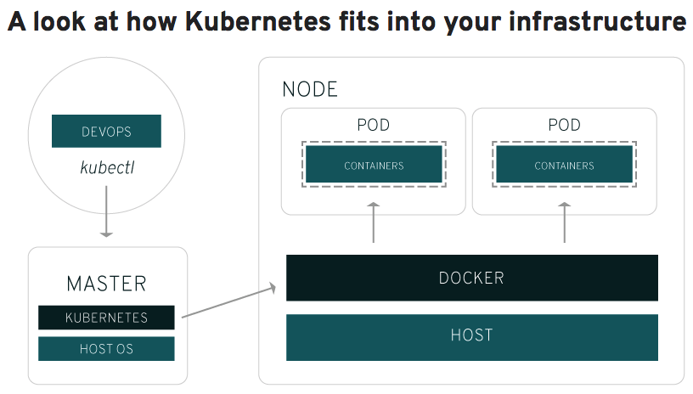
https://www.redhat.com/en/topics/containers/what-is-kubernetes

Slide 31
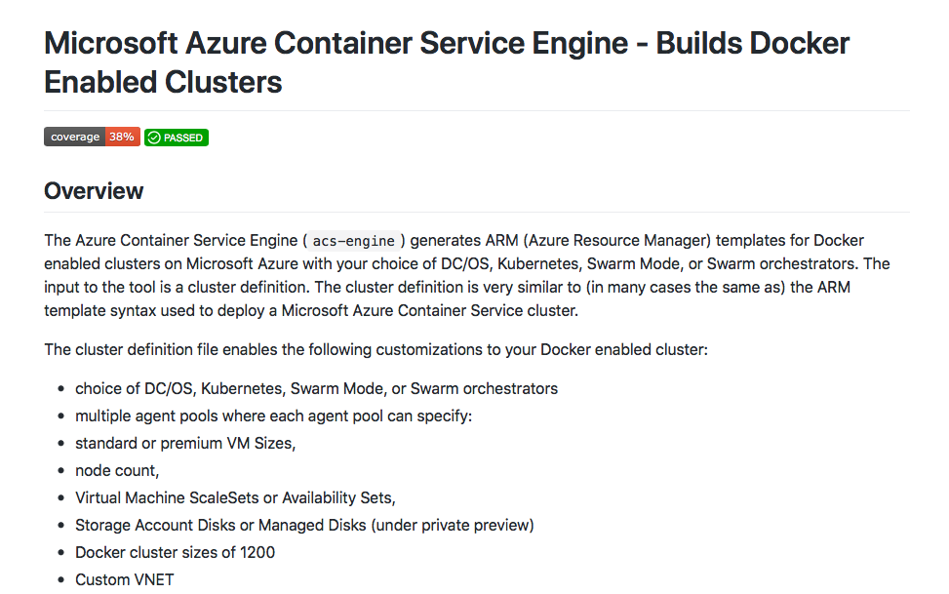
ON AZURE -ACS-Engine https://github.com/Azure/acs-engine

Slide 32
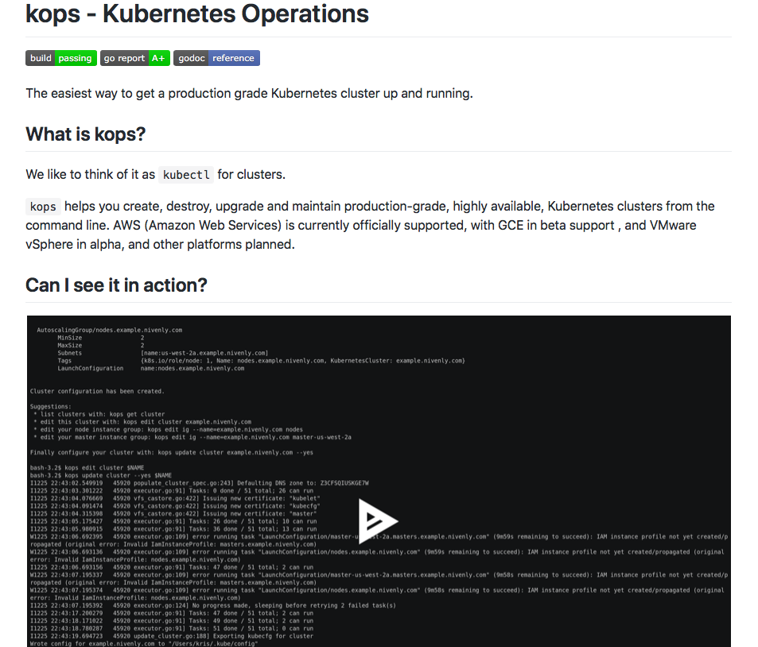
ON AWS - KOPS https://github.com/kubernetes/kops

Slide 33
Network

Slide 34
How do we connect two networks?

Slide 35
How do we securely connect two networks?

Slide 36
VPN – Virtual Private Networks
Connects networks
Many options – from easy to hard
Encrypted

Slide 37
VPN – Virtual Private Networks

Slide 38
Let’s look at VPN options
IPsec
OpenVPN

Slide 39
OpenVPN
IPSec
NIGHTMARE MODE

Slide 40
OSI Model – It’s 1999 all over again

Slide 41
Application
Presentation
Session
Transport
Network
Data
Physical

Slide 42
Application
OpenVPN
Presentation
Session
Transport
Network
IPSec
Data
Physical

Slide 43
Application
OpenVPN
Presentation
Session
Transport
Network
IPSec
Data
WHERE AND WHEN SHOULD YOU USE OPENVPN VS IPSEC?
Physical

Slide 44
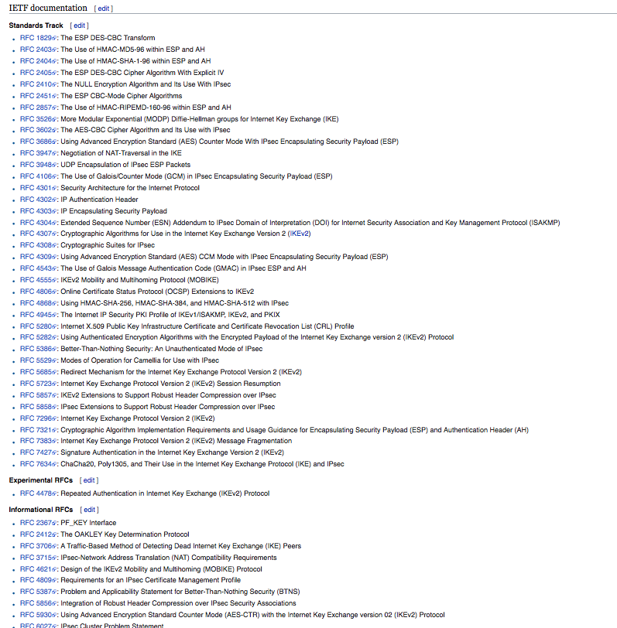
IPsec and its RFCs – This is HARD!

Slide 45
Fear not OpenIKED is here!
OpenIKED is a FREE implementation of the Internet Key Exchange (IKEv2) protocol which performs mutual authentication and which establishes and maintains IPsec VPN security policies and associations (SAs) between peers.
https://www.openiked.org

Slide 46
The solution – in pieces
Solution | AWS | Azure
Database | Cassandra | Cassandra
Compute | Kubernetes | Kubernetes
Network | VPN: OpenIKED

Slide 47
What failed

Slide 48
#FAIL!
Attempt | Approach | Why it failed?
#1 | Site-to-site VPN between AWS’s Virtual Gateway and Azure’s VPN Gateway | Tunnels did not sync Hard to troubleshoot
#2 | GRE tunnel between FreeBSD VMs | Site-to-site VPN between AWS’s Virtual Gateway and Azure’s VPN Gateway
#3 | GIF tunnel between FreeBSD VMs
#4 | IPsec tunnel on FreeBSD (need either GRE or GIF…)

Slide 49
What worked

Slide 50
#IT_WORKS!
Attempt | Approach | Notes
#1 | SSH-based VPN | For testing only. Overhead is too high. Refer to ssh(1) for details
#2 | VM to Gateway service (both AWS and Azure) | Works for NVAs such as Cisco ASA’s
#3 | IKEv2 tunnel with OpenBSD | IPsec. Easiest OSS option

Slide 51
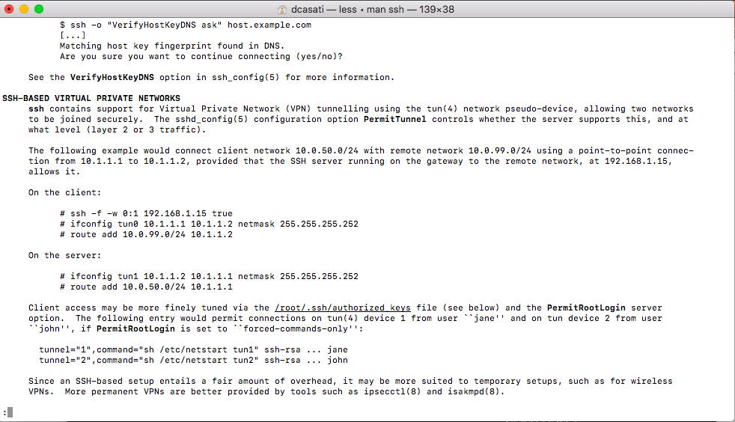

Slide 52
The solution – in pieces
Solution | AWS | Azure
Database | Cassandra | Cassandra
Compute | Kubernetes | Kubernetes
Network | VPN: OpenIKED on OpenBSD

Slide 53
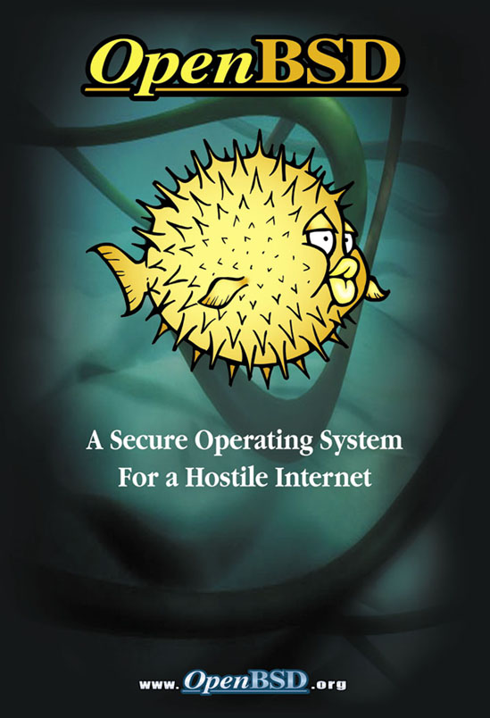
Why OpenBSD?
A FREE, multi-platform 4.4BSD-based UNIX-like operating system.
Proactive security (strlcpy, strlcat, W^X, privilege separation, …)
Many of our day-today tools in the base install (by default):
tmux, nvi, OpenSSH, mg (emacs-like), tcpdump, …
Infrastructure tools:
OpenIKED – IKEv2 Daemon
OpenBGPD – BGP daemon
OpenNTPD – NTP daemon
OpenOSPFD – OSPF daemon
OpenSMTPD – SMTP daemon
Relayd – L3/7 Load balancer
httpd – HTTP daemon
ACME-client – ACME certificate client
Rebound – DNS proxy
PF - firewall

Slide 54
END-TO-END TOPOLOGY - NETWORK

Slide 55
AWS
Create a VPC with a large network (e.g.: 192.168.0.0/16)
Carve 3 subnets (k8sDataTier, Management, VPN)
Create the OpenBSD VM with two NICs
For each NIC disable source/dest check
Add the route to Azure (e.g.: 10.0.0.0/8)
Allow traffic on the Security Groups (ports 500, 4500 UDP)
Attach an Elastic IP to the OpenBSD interface on the VPN subnet.
Configure OpenIKED.

Slide 56
Azure
Create a VNet with a large network (e.g.: 10.0.0.0/8)
Carve 3 subnets (k8sDataTier, Management, VPN)
Create the OpenBSD VM with two NICs (via Azure CLI)
For each NIC enable IP forwarding
Add the route to Azure (e.g.: 192.168.0.0/16) on the UDR
Allow traffic on the Security Groups (ports 500, 4500 UDP)
Attach a Public IP to the OpenBSD interface on the VPN subnet.
Configure OpenIKED.

Slide 57
OpenBSD
Configuration
/etc/iked.conf
-----------------------------------------------------------------------------------
local_gw = "51.143.95.27"
remote_gw = "34.233.91.14"
local_net = "10.0.0.0/16"
remote_net = "192.168.0.0/16”
kops_net = "100.64.0.0/10"
state = "active"
ikev2 $state ipcomp esp \
from $local_gw to $remote_gw \
from $local_net to $remote_net peer $remote_gw \
psk "1BigSecret”
ikev2 $state ipcomp esp \
from $local_gw to $remote_gw \
from $kops_net to $remote_net peer $remote_gw \
psk "1BigSecret”

Slide 58
OpenBSD
Commands
# rcctl enable iked
# rcctl start iked
# sysctl –w net.inet.ip.forwarding=1
To check if Ipsec is working:
# ipsecctl –sa

Slide 60
Deploy Cassandra on top of Kubernetes spanning two clouds
Our goal:

Slide 61


Slide 62
REMEMBER THIS ?

Slide 63
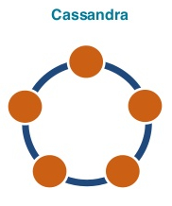
END-TO-END TOPOLOGY WITH CASSANDRA !
AWS
AZURE

Slide 64
END-TO-END TOPOLOGY - NETWORK
100.64.0.0/10 | 10.0.1.4 | KOPS Network

Slide 65
A better view of the design choices when connecting public clouds Understand that failures will happen – and that’s ok Reach out for help. Talk to the community.
Key takeaways

Slide 66
Questions ?
diegocasati @twitter
https://github.com/dcasati/cross-cloud-vpn

